Slide 1


Slide 2
UML - Standard Diagrams
Structural Diagrams
Behavioral Diagrams

Slide 3
Structural Diagrams
Class diagram
Object diagram
Component diagram
Deployment diagram

Slide 4

Example
Order System of an application

Slide 5
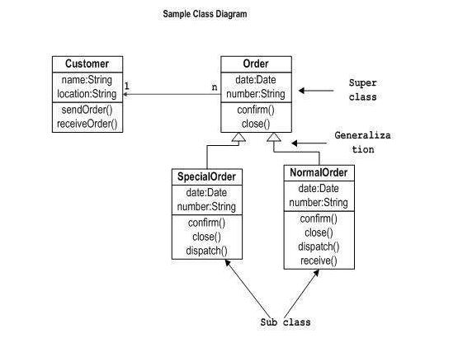
Class diagram - Static view of an application

Slide 6
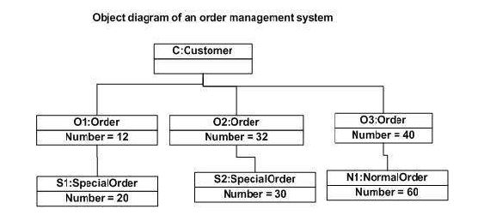
Object Diagrams - instance of a class diagram

Slide 7
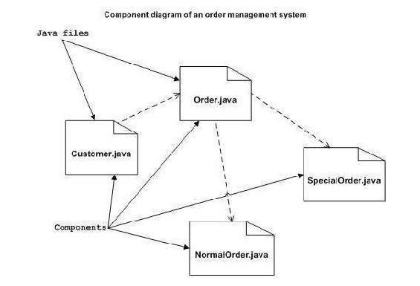
Component Diagrams - model the physical aspects of a system

Slide 8
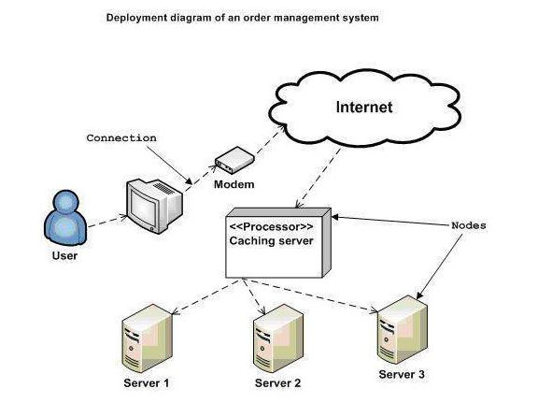
Deployment Diagrams- to visualize the topology of the physical components of a system, where the software components are deployed

Slide 9
Behavioral Diagrams - Behaviour of the system when it is running/operating
Use case diagram
Sequence diagram
Collaboration diagram
Statechart diagram
Activity diagram

Slide 10
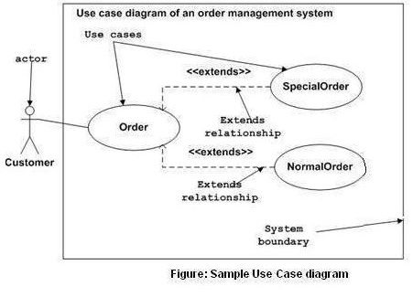
Use Case Diagrams - Used to gather the requirements of a system including internal and external influences

Slide 11
Interaction Diagrams - Interactions among the different elements in the model
Sequence diagram
Collaboration diagram

Slide 12
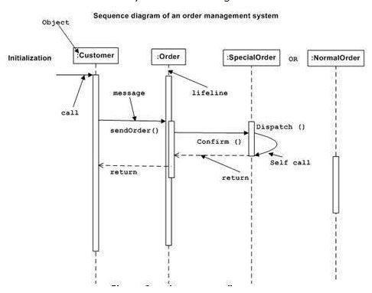
Sequence Diagram- Emphasizes on time sequence of messages

Slide 13
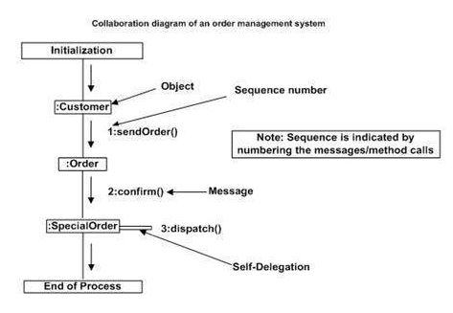
Collaboration diagram - Emphasizes on the structural organization of the objects that send and receive messages.

Slide 14
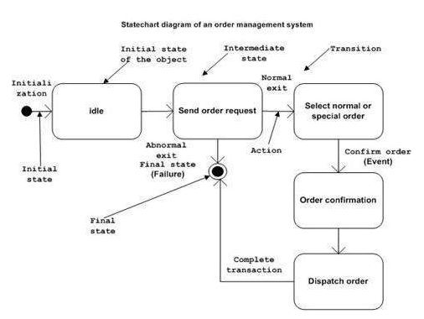
Statechart Diagrams - State machine can be defined as a machine which defines different states of an object and these states are controlled by external or internal events.

Slide 15
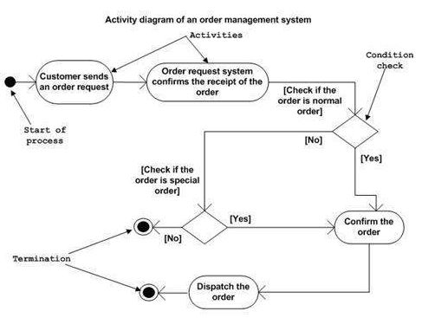
Activity Diagrams – Basically a flowchart to represent the flow from one activity to another activity

